Slide 1
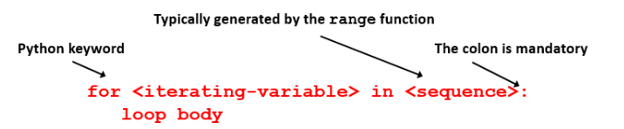
The for loop
for loops are the preferred method of iteration when it’s known how many times to repeat.

Slide 2
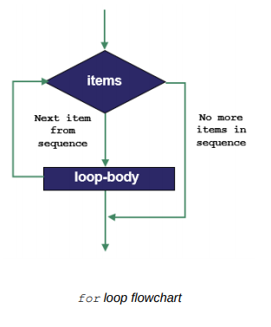

Slide 3

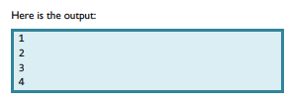
The for loop
To start, we will use a function called range(). This creates a range of integers. The numbers inside the brackets are called the arguments.
Example of basic for loop:

Slide 4
for loop
Notice that the last number printed is 4, not 5.
The second number inside the range bracket tells the computer to count up to but not including that number.

Slide 5
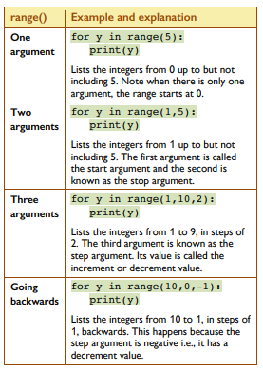

Slide 6
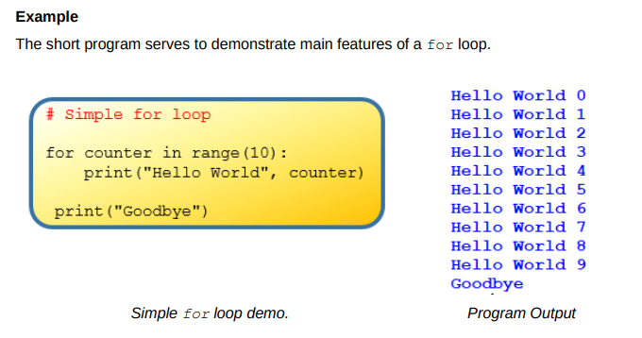
Note: Range is a built in functions which returns a list of values.
In this example, range(10) returns a list of integers from 0 to 9

Slide 7
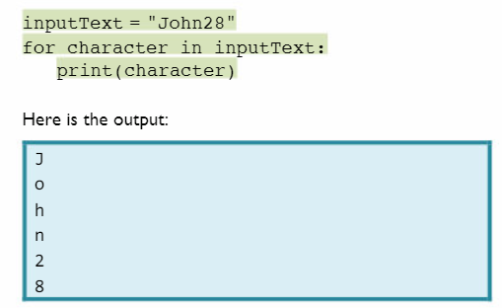
A for loop can also be used to print single characters from a string

Slide 8
Examples
https://replit.com/@suzannelinnane/for-loops#main.py

